Slide 1
8051 Addressing Modes

Slide 2
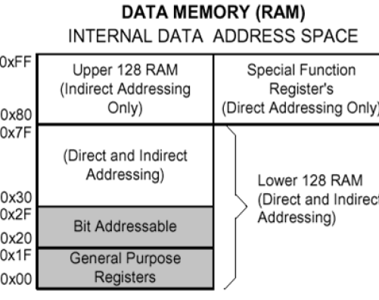
Addressing Modes
Questions: Explain briefly the addressing modes of 8051 with example for each.

Slide 3
Addressing Modes
The various formats/ways for specifying operands in the instruction are called addressing modes.
8051 has five addressing modes.
1. Immediate Addressing:
Data is immediately available in the instruction.
For example –
ADD A, #77; Adds 77 (decimal) to A and stores in A
ADD A, #4DH; Adds 4D (hexadecimal) to A and stores in A
MOV DPTR, #1000H; Moves 1000 (hexadecimal) to data pointer

Slide 4
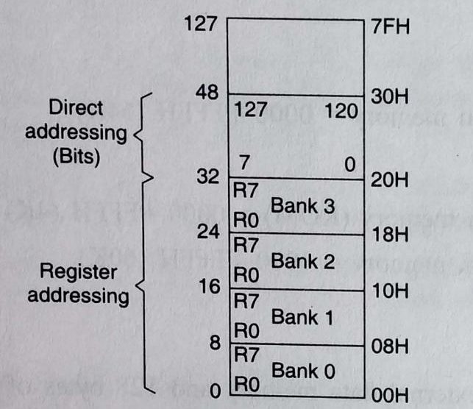
2. Register Addressing:
This way of addressing accesses the bytes in the registers(R0-R7) of the current register bank.
Data is available in the register specified in the instruction.
The register bank is decided by 2 bits of Processor Status Word (PSW).
For example-
ADD A, R0; Adds content of R0 to A and stores in A

Slide 5
3. Direct Addressing:
The address of the operand is available in the instruction.
Direct addressing has operands as byte or bit.
Direct addressing of byte provides operation on one of the following:
  Lower 128 bytes of internal data RAM
  Special function registers
Direct bit addressing provides operation on the following.
  128 bits subset of internal data RAM(20H to 2FH)
  128 bits subset of special function register address space(80HtoFFH)
For example –
MOV A, 10H; Moves content of 10H to A
4. Register Indirect Addressing:
The address of the operand is not specified directly.
The register indirect addressing uses only register R0,R1 to hold the address of the data in internal RAM.
These two registers are also referred as pointer registers or simply pointers.
The symbol @ is used along with R0 and R1to indicate indirect addressing.
For example –
MOV A, @R0 moves content of address pointed by R0 to A

Slide 6
Base Register Plus Index Register Indirect Addressing
In the instruction the operand on which the operation is to be performed, is not specified directly.
The effective address of the Operand is the sum of a base register and an offset register
either program counter or data pointer is used to hold the base address and Accumulator is used to hold offset address
EX: MOV A, @A+DPTR
MOV A, @A+PC

